Slide 1
Linear Algebra

Slide 2
Agenda
Introduction to Linear Algebra
Numpy Basics
Vector Arithmetic
Matrix Arithmetic

Slide 3
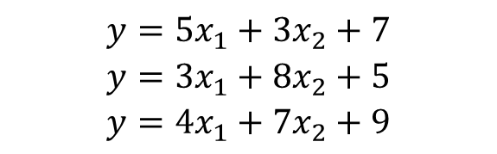
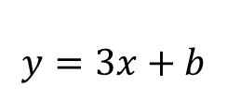
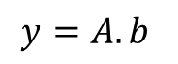
Introduction to Linear Algebra
A layman’s definition:
Linear algebra is the mathematics of data.
Matrices and vectors are the language of data.
Linear algebra is about linear combinations.
That is, using arithmetic on columns of numbers called vectors and arrays of numbers called matrices, to create new columns and arrays of numbers.
A linear equation:
A system of linear equations
Linear Algebra notation :
$$y=3x+b$$
$$y=5x_{1}+3x_{2}+7$$
$$y=3x_{1}+8x_{2}+5$$
$$y=4x_{1}+7x_{2}+9$$
$$y=A.b$$
3 Equations : 2 Unknowns - but usually we may have the other way around!

Slide 4
Linear Algebra for ML
3 Reasons not to learn it !
Why at all dig so deep like in the math below ?
It's not required.
Having an appreciation for the abstract operations that underly some machine learning algorithms is not required to use ML
It's slow
Taking months to years to study an entire related field
before machine learning will delay your work goals
It's a huge field.
Not all of linear algebra is relevant to theoretical machine learning, let alone applied machine learning.

Slide 5
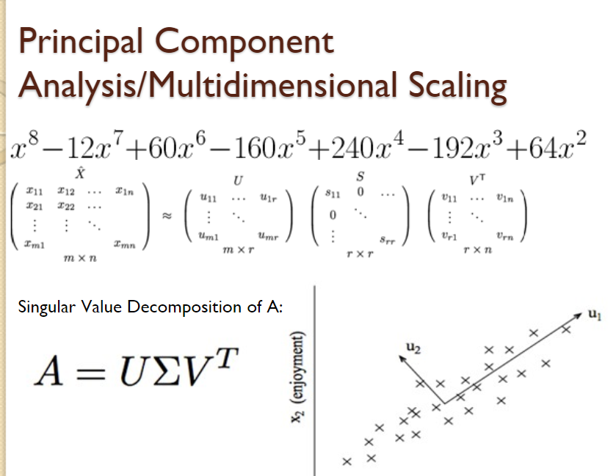
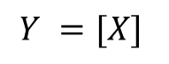
Reasons to know Linear Algebra
The famous ‘iris’ data set
Data and files
Linear algebra helps convert this to the language of vectors and matrices ; so ML models can be applied !
5.1,3.5,1.4,0.2,Iris-setosa
4.9,3.0,1.4,0.2,Iris-setosa
4.7,3.2,1.3,0.2,Iris-setosa
4.6,3.1,1.5,0.2,Iris-setosa
5.0,3.6,1.4,0.2,Iris-setosa
$$Y =[X]$$
One hot encoding
Categorical variable column
Principal Component Analysis
Dimensionality reduction
A sparse representation of data : a sub field in Linear Algebra by itself
SVD sits at the heart of PCA!

Slide 6
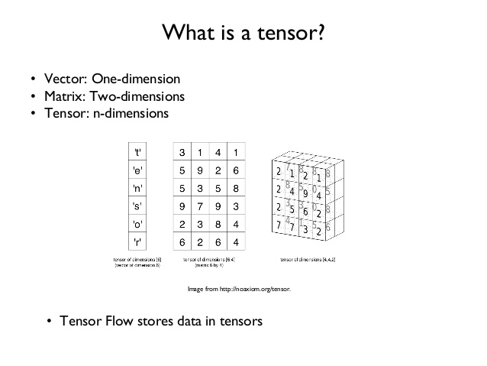
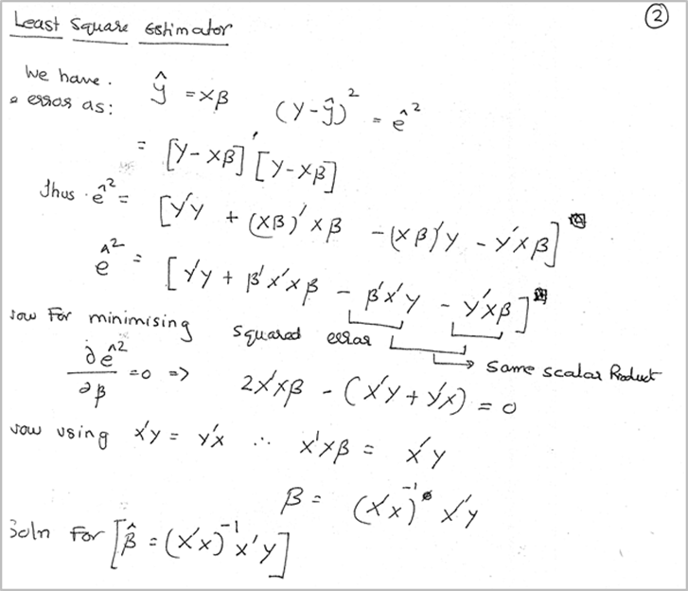

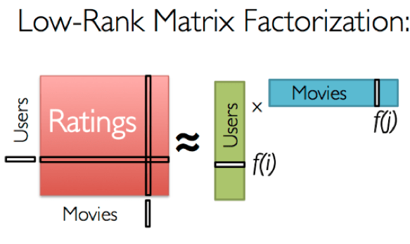
ML Applications of Linear Algebra
Deep Learning
OLS estimator for Linear Regression
Image to Matrix
Linear Algebra
Recommender systems

Slide 7
Numpy Basics
We will refer to python notebooks for the basics on this topic !

Slide 8
Vectors

Slide 9
Vector Math
Vectors
Vectors are built from components, which are ordinary numbers. You can think of a vector as a list of numbers, and vector algebra as operations performed on the numbers in the list.
Vector Addition
Vector Subtraction
Vector
v = (v1; v2; v3)
Scalar

Slide 10
Vector Math contd.
Vector Multiplication
Vector Division
Vector Dot product
Scalar Vector product

Slide 11
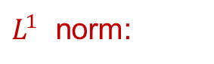
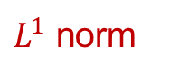

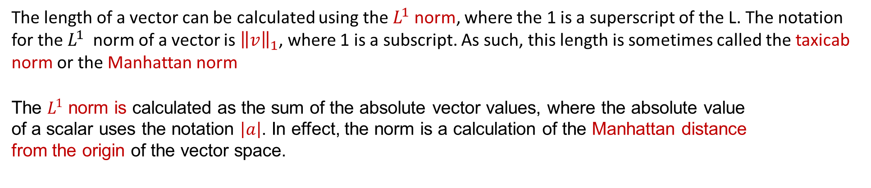
Vector norms : the $L^{1}$ norm
Vector norm :
The length of a vector is a nonnegative number that describes the extent of the vector in space, and is sometimes referred to as the vector's magnitude or the norm.
$L^{1}$ norm:
The length of a vector can be calculated using the $L^{1}$ norm, where the 1 is a superscript of the L. The notation for the $L^{1}$ norm of a vector is ${\left\|v\right\|}_{1}$, where 1 is a subscript. As such, this length is sometimes called the taxicab norm or the Manhattan norm
The $L^{1}$ norm is calculated as the sum of the absolute vector values, where the absolute value
of a scalar uses the notation $\left|a\right|$. In effect, the norm is a calculation of the Manhattan distance
from the origin of the vector space.
$L^{1}$ norm

Slide 12
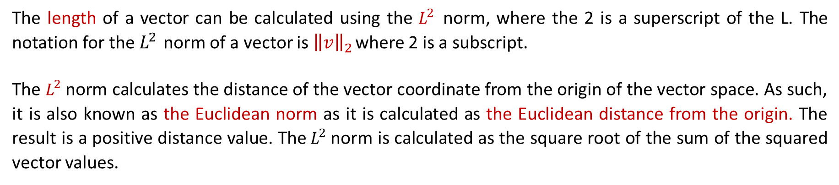
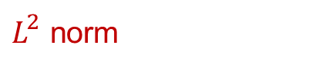
Vector norms : The $L^{2}$ norm
The length of a vector can be calculated using the $L^{2}$ norm, where the 2 is a superscript of the L. The notation for the $L^{2}$ norm of a vector is ${\left\|v\right\|}_{2}$ where 2 is a subscript.
The $L^{2}$norm calculates the distance of the vector coordinate from the origin of the vector space. As such, it is also known as the Euclidean norm as it is calculated as the Euclidean distance from the origin. The result is a positive distance value. The${ L}^{2}$norm is calculated as the square root of the sum of the squared vector values.
$L^{2}$norm

Slide 13
Matrices and Matrix Arithmetic

Slide 14
Matrices
Addition
Subtraction
Hadamard product
Division

Slide 15
Matrix Math contd.
(Dot product)
Matrix Matrix Multiplication
Matrix Vector Multiplication

Slide 16
Matrix Math contd.
Matrix Scalar Multiplication

Slide 17
Types of Matrices
Square Matrix
A square matrix is a matrix where the number of rows (n) is equivalent to the number of columns (m).
Symmetric Matrix
A symmetric matrix is a type of square matrix where the top-right triangle is the same as the bottom-left triangle.

Slide 18
Types of matrices contd.
Triangular Matrix
A triangular matrix is a type of square matrix that has all values in the upper-right or lower-left
of the matrix with the remaining elements filled with zero values
Upper Triangular Matrix
Lower Triangular Matrix

Slide 19
Types of matrices contd.
Diagonal Matrix
A diagonal matrix is one where values outside of the main diagonal have a zero value, where the
main diagonal is taken from the top left of the matrix to the bottom right.
Non Sq: Diagonal Matrix
A diagonal matrix does not have to be square. In the case of a rectangular matrix, the diagonal would cover the dimension with the smallest length;

Slide 20
Types of matrices contd.
Identity Matrix
Othogonal Matrix
An identity matrix is a matrix that does not change any vector when we multiply
that vector by that matrix.
Two vectors are orthogonal when their dot product equals zero. If the length of each vector is 1
then the vectors are called orthonormal because they are both orthogonal and normalized.
OR
Formal defn:
Example

Slide 21
Matrix operations
Transpose
A defined matrix can be transposed, which creates a new matrix with the number of columns
and rows flipped.
Inverse
Matrix inversion is a process that finds another matrix that when multiplied with the matrix,
results in an identity matrix. Given a matrix A, and matrix B, such that AB = In or BA = In
We have
Where

Slide 22
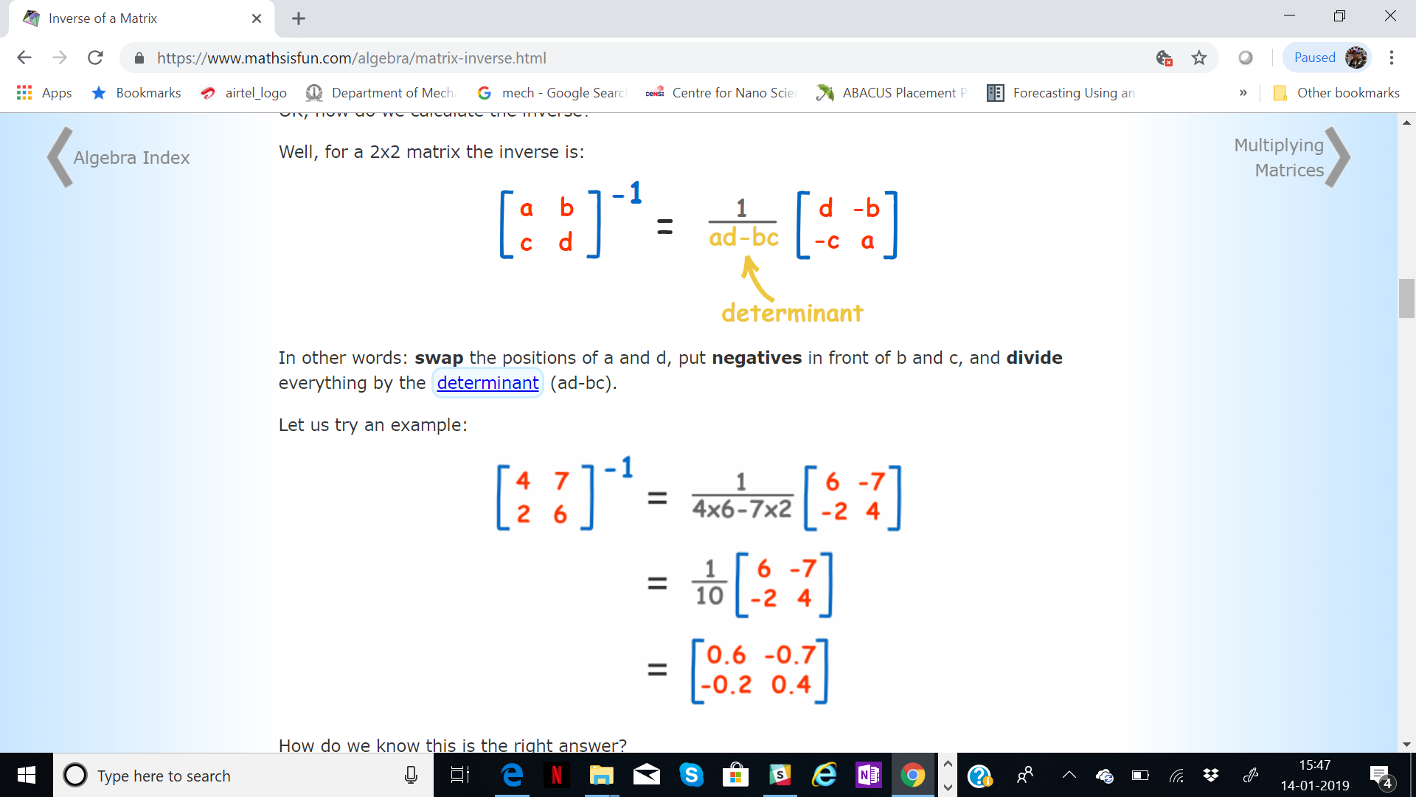
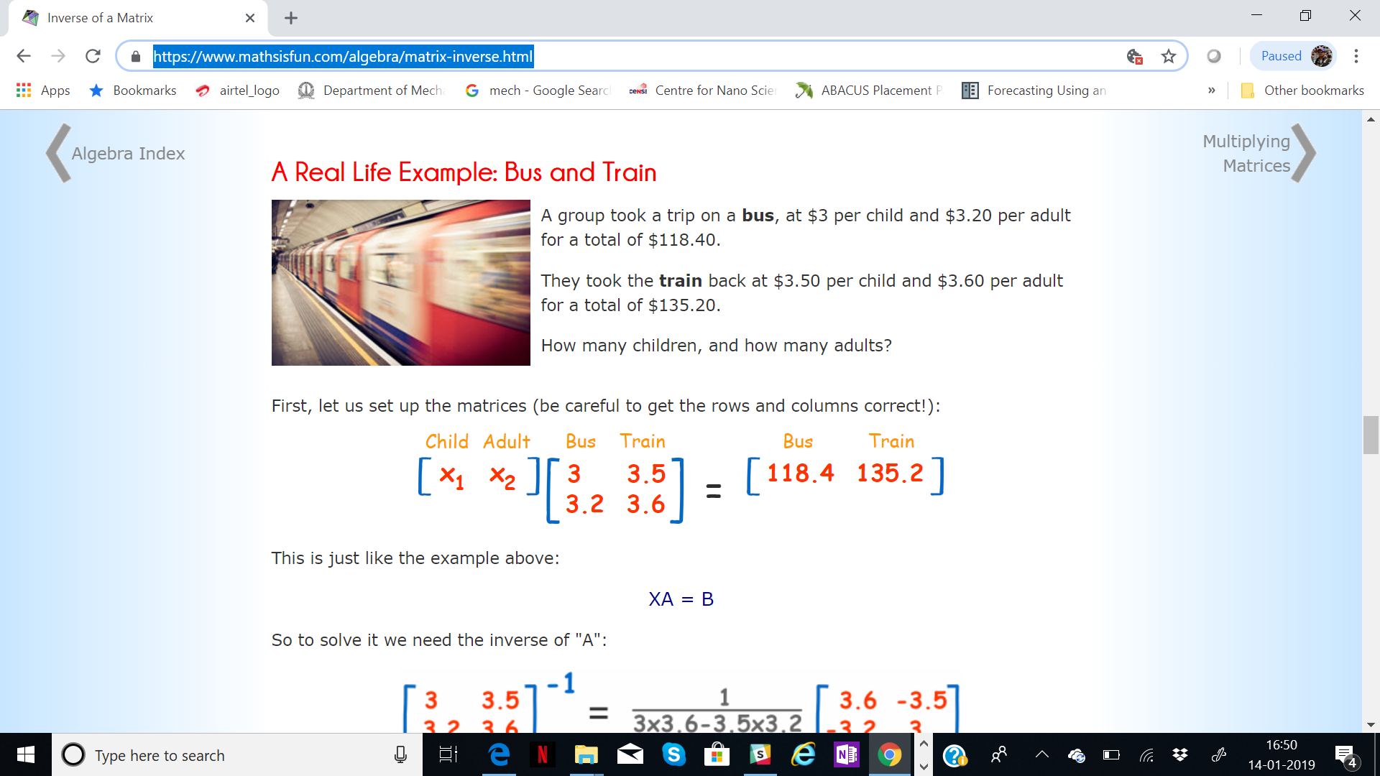
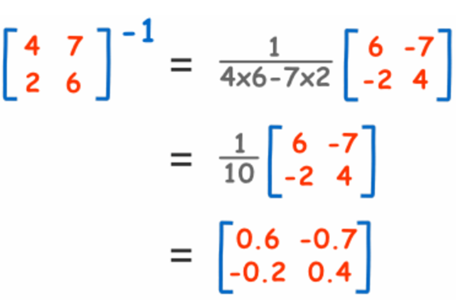
Inverse of a matrix: contd.
How do we find inverse ?
A simple 2x2 square matrix example
Reality is not square always!
https://www.mathsisfun.com/algebra/matrix-inverse.html

Slide 23
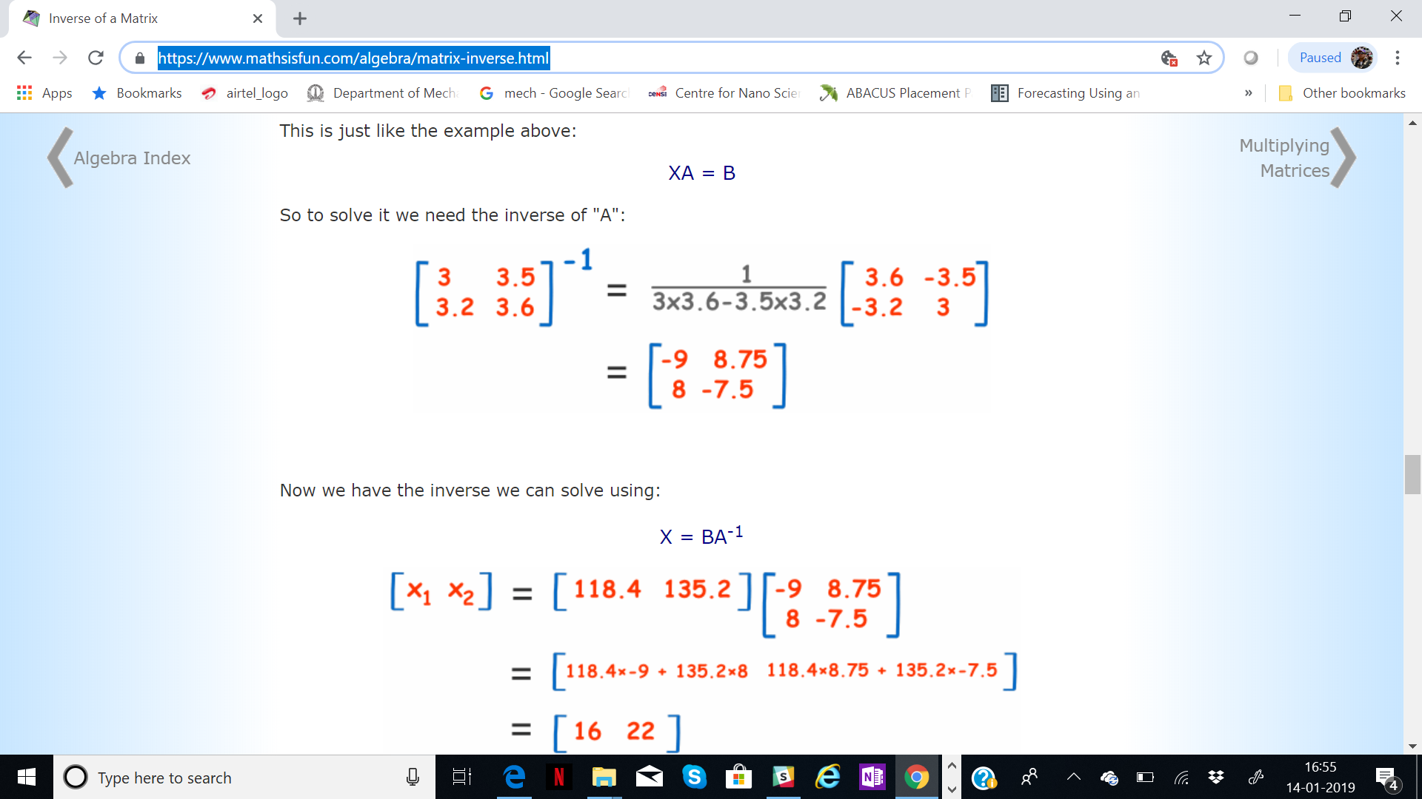
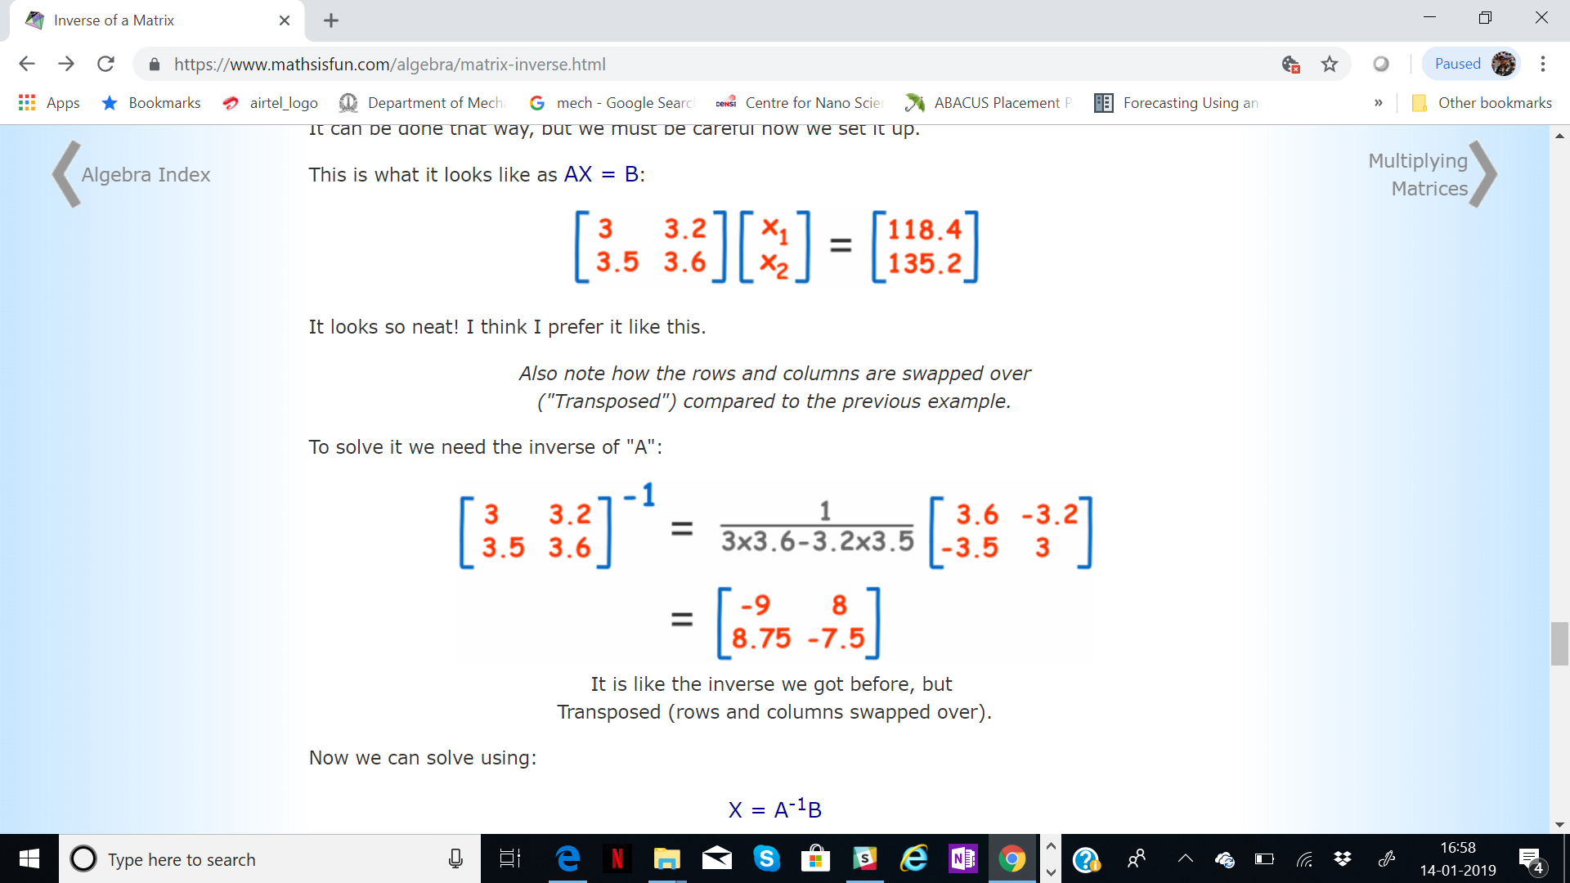
Inverse of a matrix: contd.
The problem as it is :
Set up now in a more well known way!

Slide 24
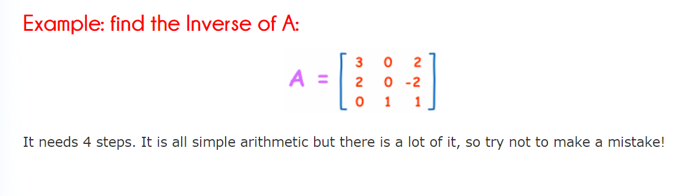
Analytical steps to compute inverse .
Calculating the Matrix of Minors,
Then turn that into the Matrix of Cofactors,
Then the Adjugate, and
multiply that by 1/Determinant.

Slide 25
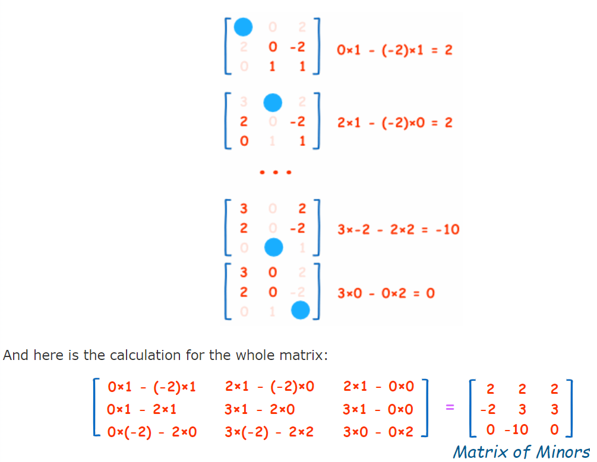
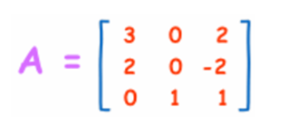
Analytical steps to compute inverse .
Step1 : Matrix of Minors
For each element of the matrix:
Ignore the values on the current row and column
Calculate the determinant of the remaining values

Slide 26
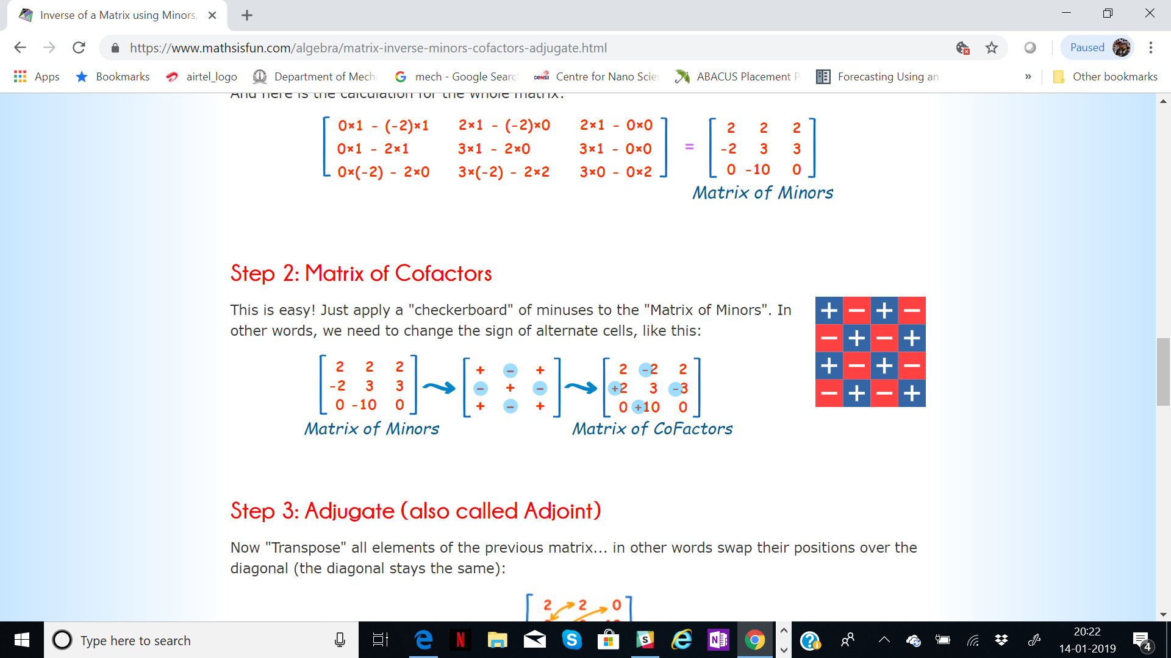
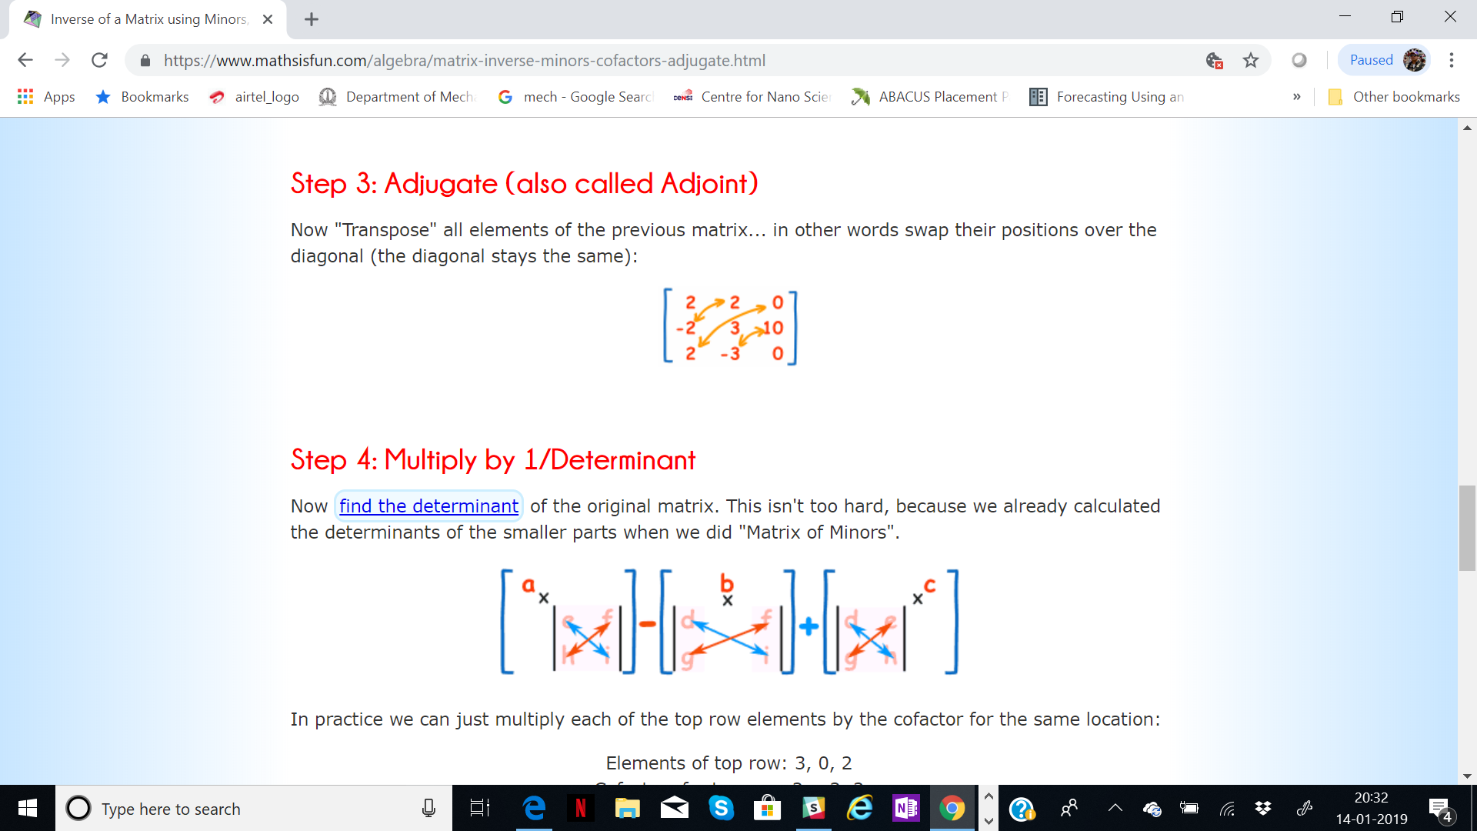
Analytical steps to compute inverse
Step 2 : Matrix of Co factors
This is easy! Just apply a "checkerboard" of minuses to the "Matrix of Minors". In other words, we need to change the sign of alternate cells, like this:
Step 3 : Adjugate or Adjoint
Now "Transpose" all elements of the previous matrix... in other words swap their positions over the diagonal (the diagonal stays the same):

Slide 27
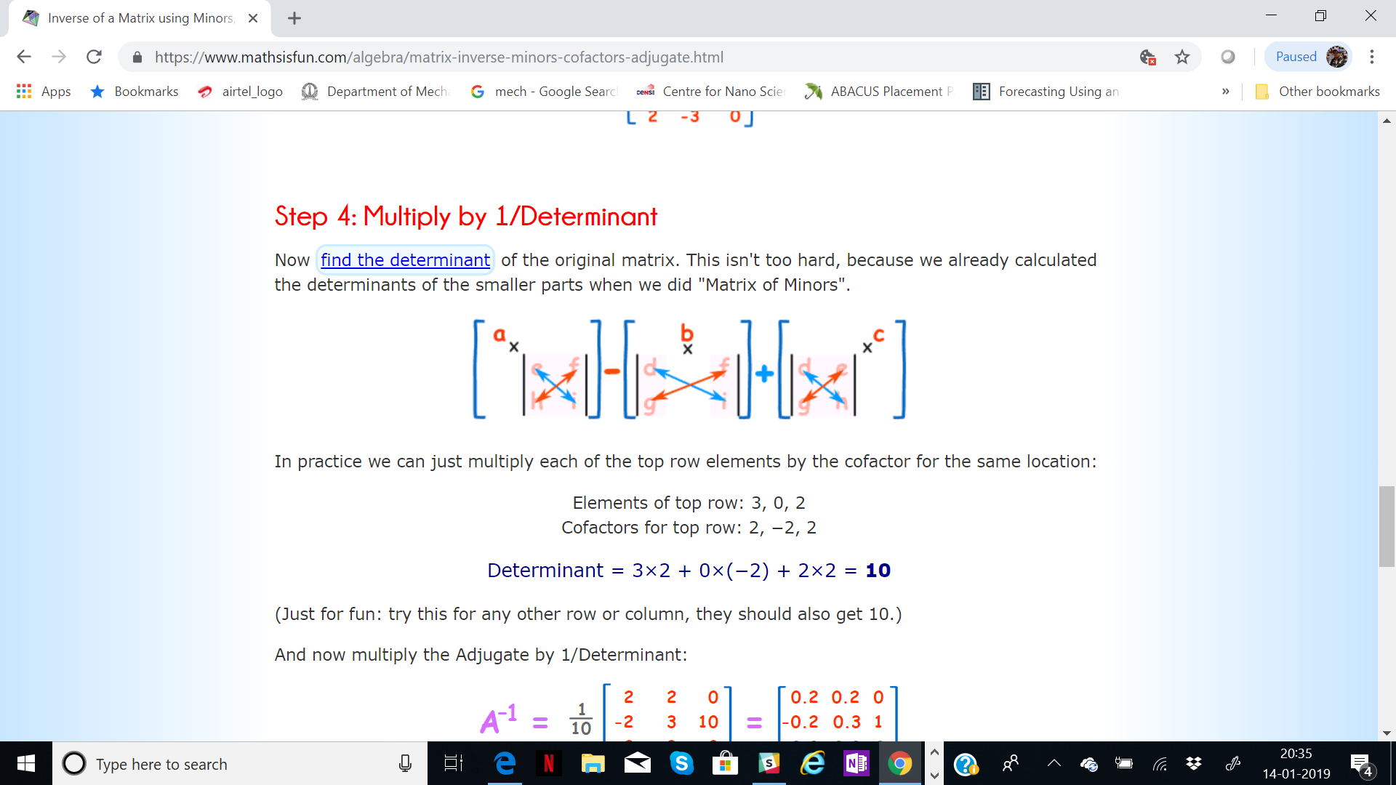
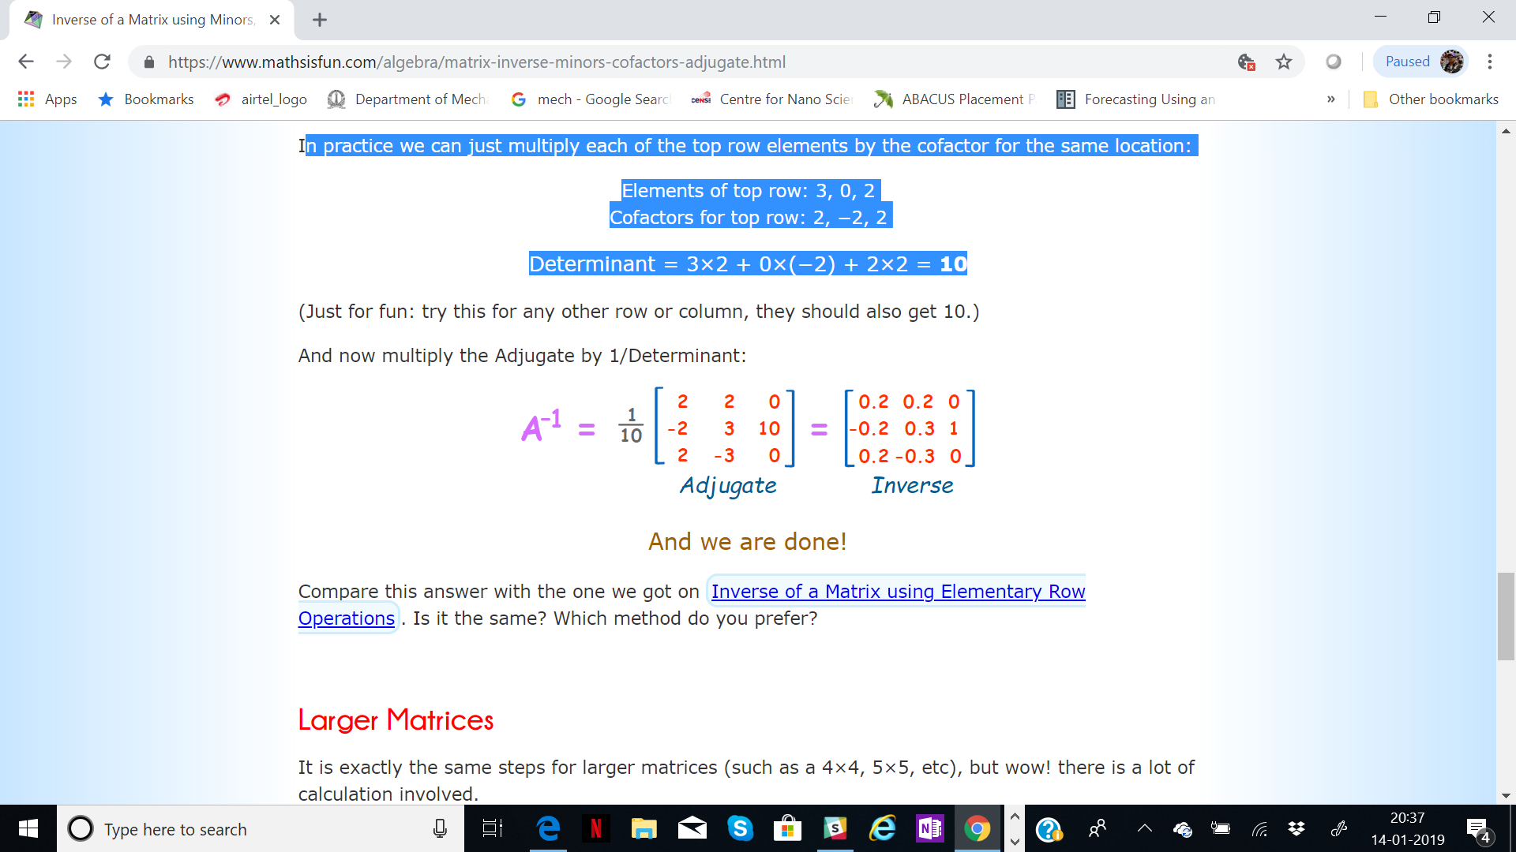
Analytical steps to compute inverse .
Step 4 : Multiply by 1/determinant
Let us find the determinant first!
Now multiply the Adjugate by 1/determinant
In practice we can just multiply each of the top row elements by the cofactor for the same location:
Elements of top row: 3, 0, 2
Cofactors for top row: 2, −2, 2
Determinant = 3×2 + 0×(−2) + 2×2 = 10

Slide 28
Trace
The trace operator gives the sum of all of the diagonal entries of a matrix
The operation of calculating a trace on a square matrix is described using the notation tr(A)
where A is the square matrix on which the operation is being performed.
Thus for a 3x3 matrix we have

Slide 29
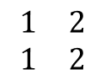
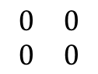
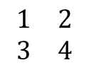
Rank
The rank of a matrix is the estimate of the number of linearly independent rows or columns in
a matrix. The rank of a matrix M is often denoted as the function rank().
A 2x2 matrix of Rank 0
$$\begin{matrix}0 & 0 \\ 0 & 0\end{matrix}$$
A 2x2 matrix of Rank 1
$$\begin{matrix}1 & 2 \\ 1 & 2\end{matrix}$$
A 2x2 matrix of Rank 2
$$\begin{matrix}1 & 2 \\ 3 & 4\end{matrix}$$

Slide 30
Thank You

